Slide 1
Microservices and DevOps
DevOps and Container Technology
Docker Volumes
Henrik Bærbak Christensen

Slide 2
ReCap: Persistence
Of course, we never install MongoDB in this course…
We
docker run –d –p 27017:27017 mongo:3.4
And can now contact our mongo db using
localhost:27017
But… What happens to the data we write to it???
Exercise: Any ideas?

Slide 3
You probably guessed right!
Docker container = onion type file system
MongoDB writes in files in /data/db
… which are in the container’s file system
… which is simply destroyed when the container is removed…
[Uhum, this is actually not correct…]

Slide 4
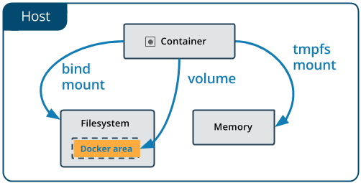
The Old Way
The old way of handling this is bind mounts
Docker run … -v ~/my-mongo-data:/data/db mongo:3.4
This mounts a local folder on host as though it was a folder within the container
Net result:
All data is persisted on the host!

Slide 5
The New Way
New way: Named Volumes

Slide 6
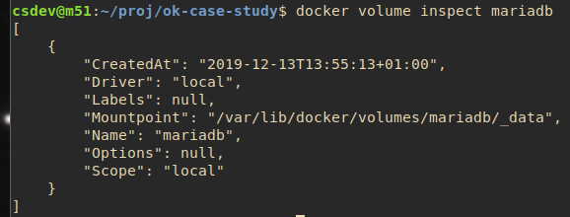
Example
Still the folder in the container, but now just a ‘volume’ as source…
Now this folder is ‘rewired’ to some persistent area, managed by Docker

